Slide 1
The Aussie Dream Chaser
Aussie Dream Chasers
Aussie Dream Planners
Moving house
Holiday ideas
Weekend getaways
Community planners
Local government
Researchers
Notes:
Can click either button to start that chain

Slide 2

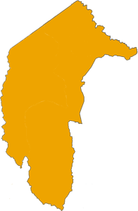
The Aussie Dream Chaser
Hunting your Australian haven
Facility type
Cafes/restaurants
Sport fields
Boat ramps
BBQs
Swimming pools
Dog parks
My location: ____________________________
# of desirable facilities: __
Ozzie-meter (facilities/100 residents): ___
Recommended post code: ____
Notes:
Click the ACT

Slide 3
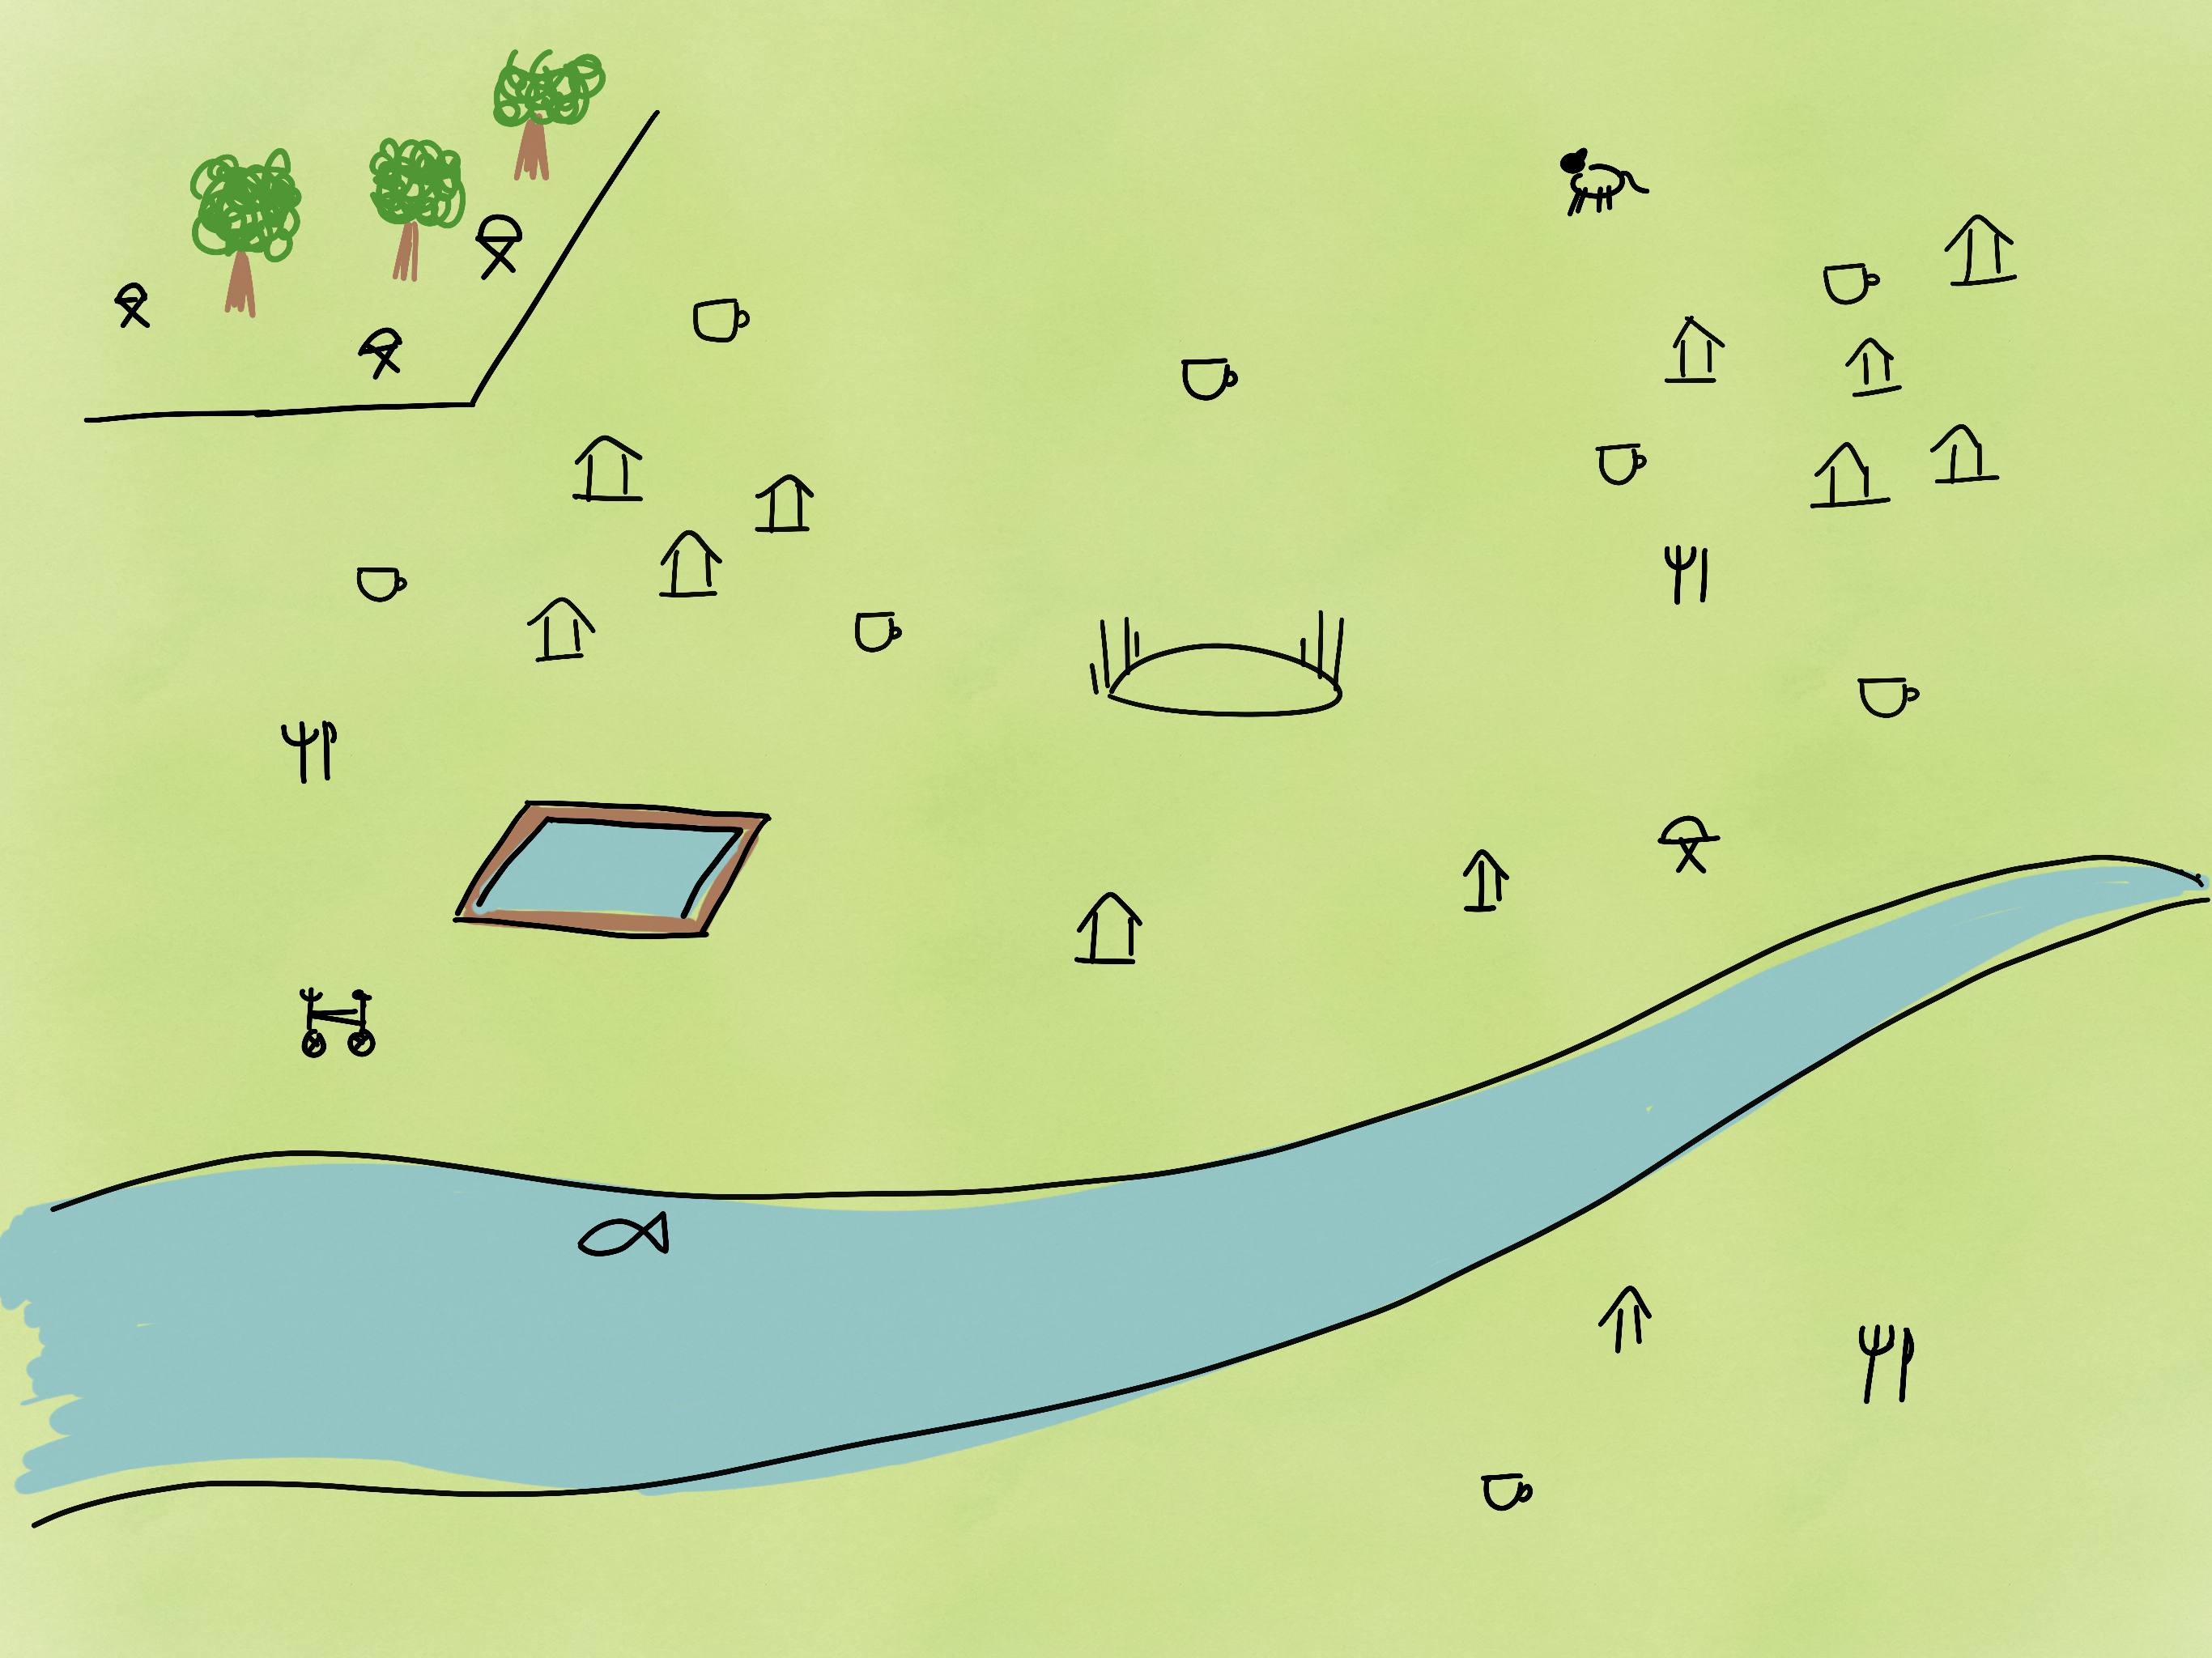
The Aussie Dream Chaser
Hunting your Australian haven
Facility type
Cafes/restaurants
Sport fields
Boat ramps
BBQs
Swimming pools
Dog parks
My location: ____________________________
# of desirable facilities: __
Ozzie-meter (facilities/100 residents): ___
Recommended post code: ____
Notes:
Click cafes/restaurants

Slide 4

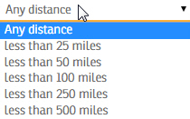
The Aussie Dream Chaser
Hunting your Australian haven
Facility type Within distance
Cafes/restaurants
Sport fields
Boat ramps
BBQs
Swimming pools
Dog parks
My location: ____________________________
# of desirable facilities: __
Ozzie-meter (facilities/100 residents): ___
Recommended post code: ____
Notes:
Click any distance and note that it wouldn't be in miles.

Slide 5
The Aussie Dream Chaser
Hunting your Australian haven
Facility type Within distance
Cafes/restaurants 5 km
Sport fields
Boat ramps
BBQs
Swimming pools
Dog parks
My location: ____________________________
# of desirable facilities: __
Ozzie-meter (facilities/100 residents): ___
Recommended post code: ____
Notes:
Click my location

Slide 6
The Aussie Dream Chaser
Hunting your Australian haven
★
Facility type Within distance
Cafes/restaurants 5 km
Sport fields
Boat ramps
BBQs
Swimming pools
Dog parks
My location: 33 Marsh St, Castlemaine, VIC
# of desirable facilities: 2
Ozzie-meter (facilities/100 residents): ___
Recommended post code: ____
Notes:
Click BBQs

Slide 7
The Aussie Dream Chaser
Hunting your Australian haven
★
★
Facility type Within distance
Cafes/restaurants 5 km
Sport fields
Boat ramps
BBQs 1 km
Swimming pools 10 km
Dog parks
My location: 33 Marsh St, Castlemaine, VIC
# of desirable facilities: 2
Ozzie-meter (facilities/100 residents): 0.32
Recommended post code: 3056
Notes:
Click red box to return to home page!

Slide 8
The Aussie Dream Chaser
Creating the Australian haven
Available facilities
Cafes/restaurants
Sport fields
Boat ramps
BBQs
Swimming pools
Dog parks
Local government area: ________________
# of facilities: __
# of residents: _____
Ozzie-meter (facilities per 100 residents): ____
Notes:
Click local government area

Slide 9
The Aussie Dream Chaser
Creating the Australian haven
Available facilities
Cafes/restaurants
Sport fields
Boat ramps
BBQs
Swimming pools
Dog parks
Local government area: Melton, VIC
# of facilities: 23
# of residents: 4,562
Ozzie-meter (facilities per 100 residents): 0.51

